Slide 1
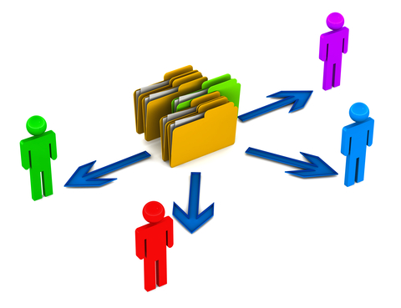
File Share Options
High level overview
mdlug 2025
Pat Baker

Slide 2
Pat Baker
Information Assurance (CyberSecurity), Intelligence Analyst, Technology Analyst, Linux/Unix Knowledge
OtakuSystems LLC
otakusystems.com
twitter: @otakusystems
info@otakusystems.com
Technologist, Futurist, Philosopher, Geek
- Seeker of wisdom and knowledge

Slide 3
Disclaimer
Not responsible for any damage done to you, your friends, your accounts, your pet goldfish, etc. All information is for educational or general knowledge purposes.
Information held within may or may not be legal by your country, state or business.
If it's not legal then you should do it?

Slide 4
Issues
With people moving from place to place and machine to machine (including: Phone, tablet, etc.), getting to your files can be difficult.
You also want to make sure the files are stored centrally and securely from others having access that do not need to have like, governments, Businesses or other people.

Slide 5
File share options covered.
From company's: dropbox, google drive, Microsoft, and others
Open source:
Hardware: USB thumb drives, HDD

Slide 6
Some Issues
Getting to the data from multiple machines and locations.
Keeping the data secure in transport and being stored.
Who owns the data on the servers, of the company goes belly-up can you get it?
Who controls the encryption keys?

Slide 7
Some Issues
Ease of use on multiple devices, and the number of devices that can be used.
Having a secure centrally located data, but being easy to replicate if needed to other machines.
Data location and what government groups can get fingers on it.

Slide 8
Some Issues
Governments can force the providers to hand over any data and are gagged so not to tell you they did.
Some will have a ‘Canary’ document so keep a eye on it closely, if my help but not a always solution.

Slide 9

The big players

Slide 10
Owned by big company
Dropbox
iCloud
Google Drive
Microsoft Drive
Amazon Cloud Storage
SpiderOak

Slide 11
DropBox
Central location of file and folder location, from that location data is transferred to external devices.
Upload of changes to central server are done in near real time.
Speed up updates are done via upload of only changed blocks.

Slide 12
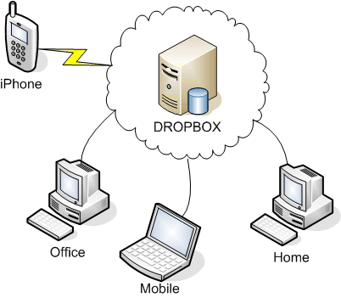
DropBox

Slide 13
DropBox
SSL exchange synchronization to central server and between external clients.
Limited encryption of files on the central server, files and folders are not encrypted in local clients. (dropbox has capability to decrypt data on central server if requested)

Slide 14
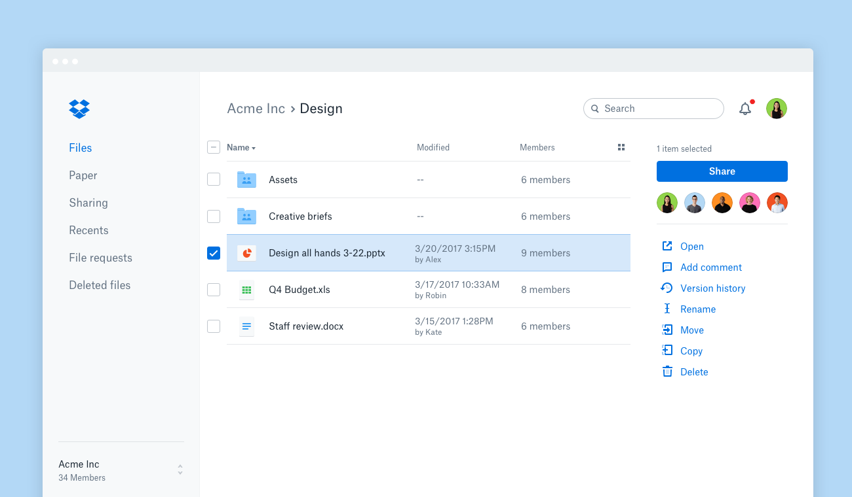

Slide 15
DropBox
Pros: Easy to use, multi platforms (Android, iOS, Linux, macOS, Microsoft Windows, Windows Phone) , normally no need to open port in firewall. Been around from 2007, MIT students started it. Free tier available, paid version gives more features and storage.

Slide 16
DropBox
Cons: Data not fully encrypted on central server (dropbox can decrypt if chose). Not full end to end encryption SSL type only. Encryption keys accessible by employees. Third party hack in 2012 and 2014 passwords and accounts compromised.

Slide 17
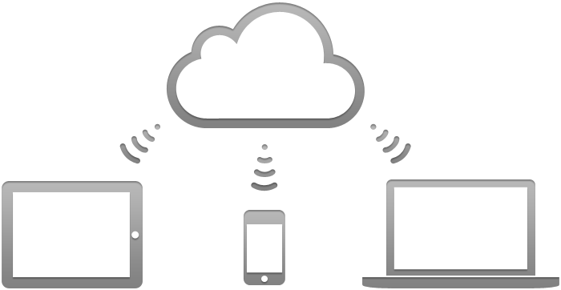
iCloud

Slide 18
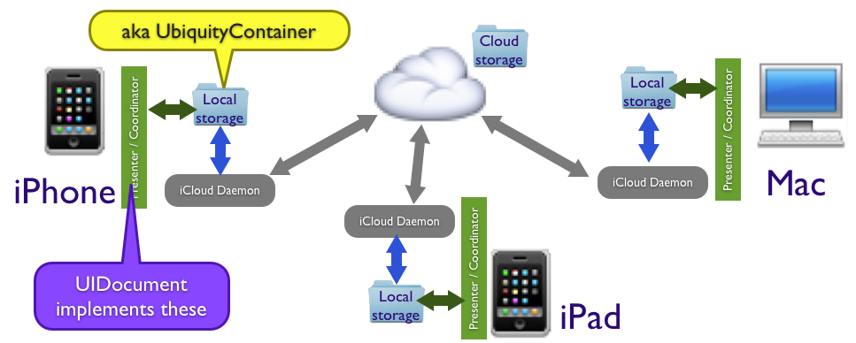
iCloud

Slide 19
iCloud
Apple cloud storage, SSL exchange between server and apple only clients, web based front in available.

Slide 20
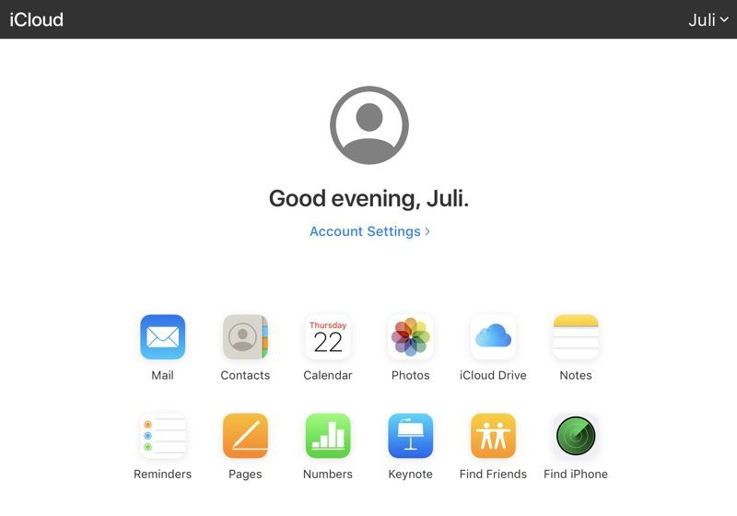

Slide 21
iCloud
Pros: Apple only environment, 5 gig free, more as paid system. SSL type file exchange from client to Apple cloud server. Apple integrated to all apple products by default. More security minded then other public cloud storage services.

Slide 22
iCloud
Cons: Apple holds encryption keys and able to decrypt as desired. No full end-to-end encryption between client and server. Apple only environment, closed source code. Multiple leaks published but little explanation of them. Data stored in multi-country's. Data will and has been handed over to governments in the past.

Slide 23
iCloud
https://en.wikipedia.org/wiki/ICloud
https://www.pocket-lint.com/apps/news/apple/131058-what-is-apple-icloud-drive-and-how-does-it-work

Slide 24
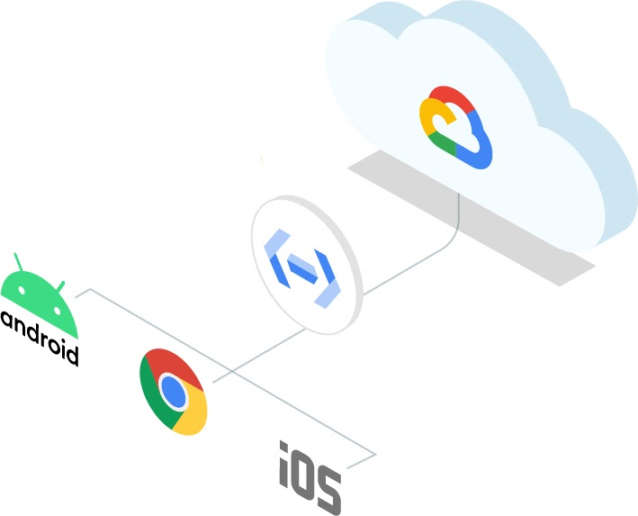
Google Storage Drive

Slide 25
Google Storage Drive
Offered by Google, included is a google suite of products (mail, wp, storage). Created 2008, available to large number of OS platforms. Large number of servers in multi countries for use. Designed for “source of truth” issues.

Slide 26
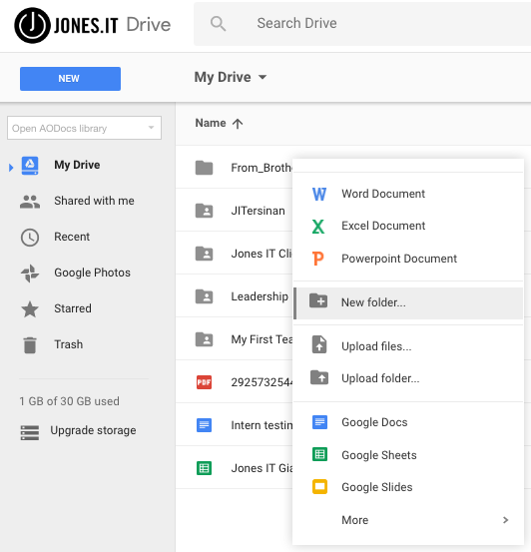

Slide 27
Google Storage Drive
Pros: Encrypted on cloud servers, end-to-end ssl file exchange. Most storage default then all other services. Two-step verification option with tokens or external systems.

Slide 28
Google Storage Drive
Cons: Google keeps encryption keys and is able to decrypt as desired, ad based company. Near impossible to contact a human for issues. Known data breaches in past. Programmers like to modify but not define what changed, push out changes with little warning, kills products.

Slide 29
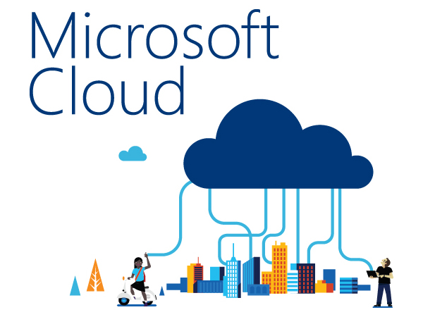
Microsoft Storage Drive

Slide 30
Microsoft Storage Drive
Offered by Microsoft, most times need to have a 365 outlook subscription to have any large storage. Added baggage of other Microsoft apps.

Slide 31
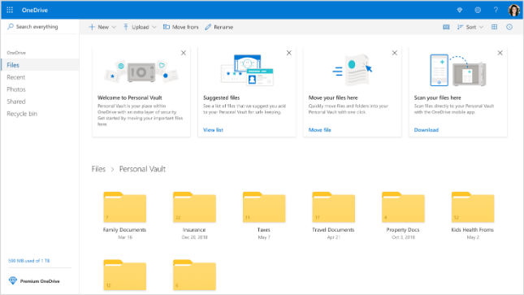

Slide 32
Microsoft Storage Drive
Pros: 5 free storage tier and 1T storage with office 365 subscription. Web based access for all platforms, Windows and Mac app access. Office collaboration option.

Slide 33
Microsoft Storage Drive
Cons: Closed source, primary Windows and Mac OS unless limited use of web browser functionality. Third party Linux connection options. Encryption keys kept by Microsoft, SSL data exchange system. General usage of “Source-of-truth” data support.

Slide 34
Microsoft Storage Drive
https://www.microsoft.com/en-us/microsoft-365/onedrive/online-cloud-storage
https://en.wikipedia.org/wiki/Microsoft_OneDrive

Slide 35
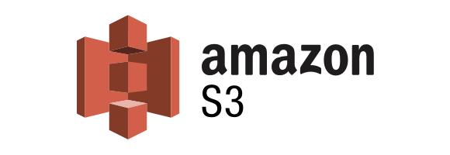
Amazon AWS S3 Bucket storage

Slide 36
AWS S3 Storage
Offered by Amazon, AWS S3 storage buckets. Subscription to AWS services required, free tier for one year is available Gives access most all AWS services.

Slide 37
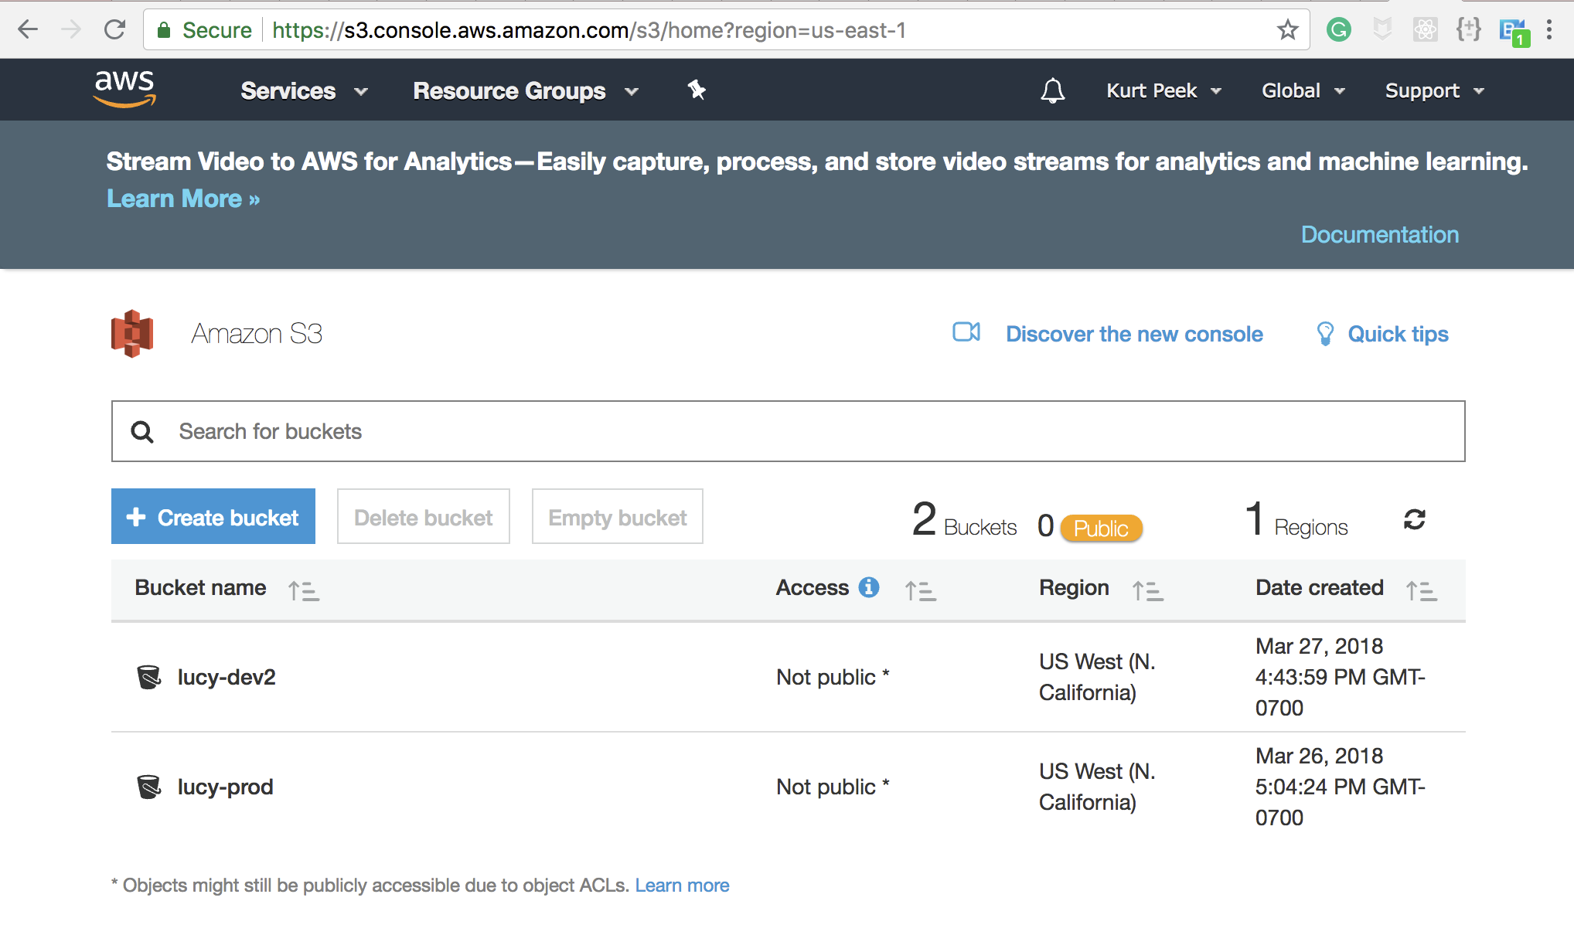

Slide 38
AWS S3 Storage
Pros: Free usage option for a year for new people. Use of most all services. Drive space can be near unlimited if can pay for it. Has other services that can be used. Able to mount ‘buckets; on most all systems (Linux, Mac, Window, IOS, Android)

Slide 39
AWS S3 Storage
Cons: Storage cost can get large do to the way Amazon tracks data storage. Charged for inter and remove of data. Different storage options, can get very confusing. Can be hard to secure, many records of storage breaches do to poor buckets configuration.

Slide 40
AWS S3 Storage
https://aws.amacon.com
https://en.wikipedia.org/wiki/Amazon_s3

Slide 41

SpiderOak

Slide 42
SpiderOak
An online backup and file hosting service that allows users to access, synchronize and share data using a cloud-based server. Encrypted cloud storage and client-side encryption key creation, so SpiderOak employees cannot access users' information.

Slide 43
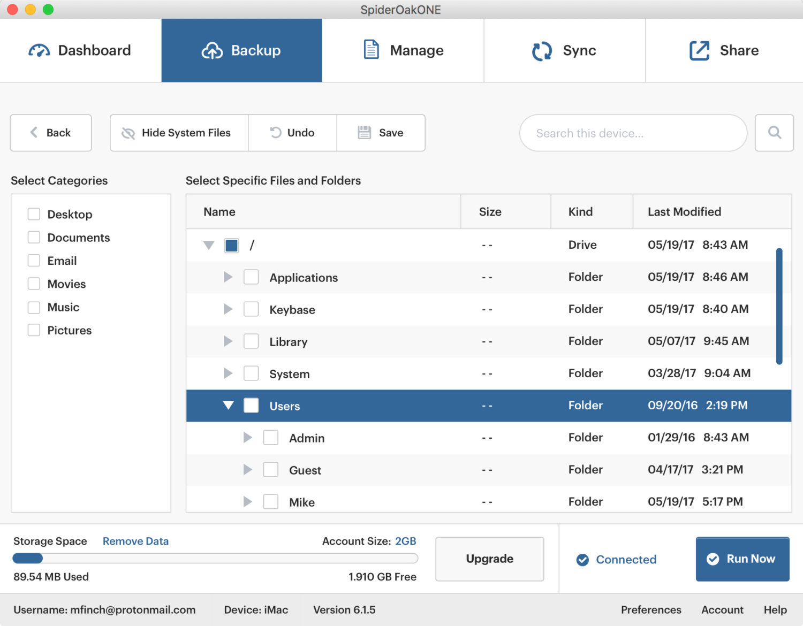

Slide 44
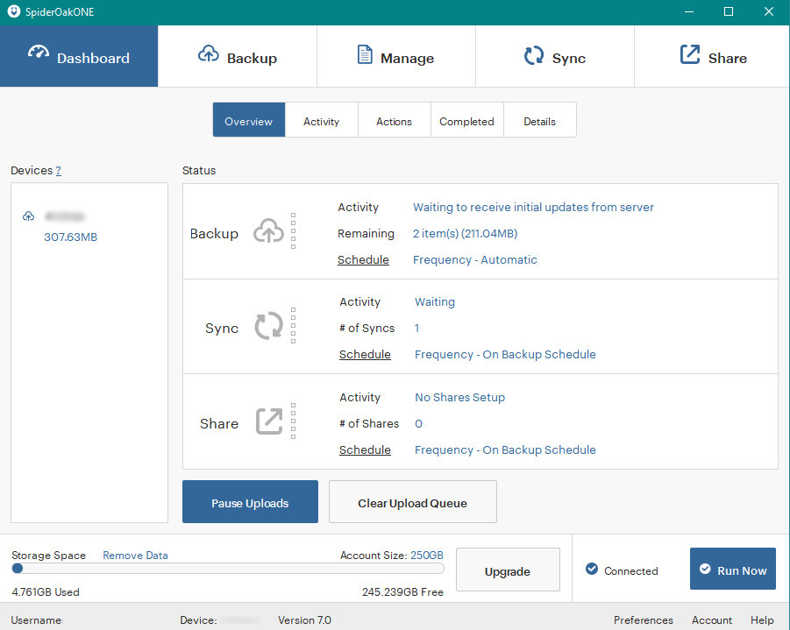

Slide 45
SpiderOak
Pros: Encrypted cloud storage and client-side encryption key creation, so SpiderOak employees cannot access users' information. US based company.

Slide 46
SpiderOak
Cons: (do you believe them?) Closed source code, discontinued using the phrase "zero knowledge" on encryption. On August 1, 2018, the warrant canary on SpiderOak's website briefly vanished.

Slide 47
SpiderOak
https://spideroak.com/
https://en.wikipedia.org/wiki/SpiderOak
https://www.cloudwards.net/spideroak-vs-dropbox/

Slide 48
If using Public cloud
A good idea - Encrypt data before you store it in their platforms. Use vericrypt, Tomdstone, even OSX encrypted volume. As long as only you have the encryption key to the data.
Always remember, if the site has option to change passwords, then they have the keys, not you.

Slide 49
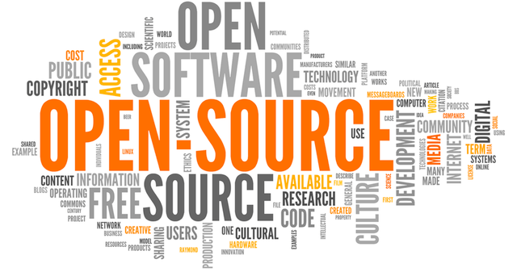
Just Roll your own

Slide 50
Data Held by you – single or mix
Syncthing
Tailscale
Magic Wormhole
OnionShare

Slide 51
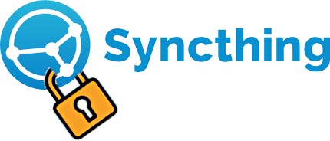
Syncthing

Slide 52
Syncthing
Created 2013, Multiple OS, open-source file and folder exchange system, exchange between local and device over the internet. Local server user controlled hardware. TLS end to end encryption. File synchronization only, transport of data only. SHA256 hash of each block.

Slide 53
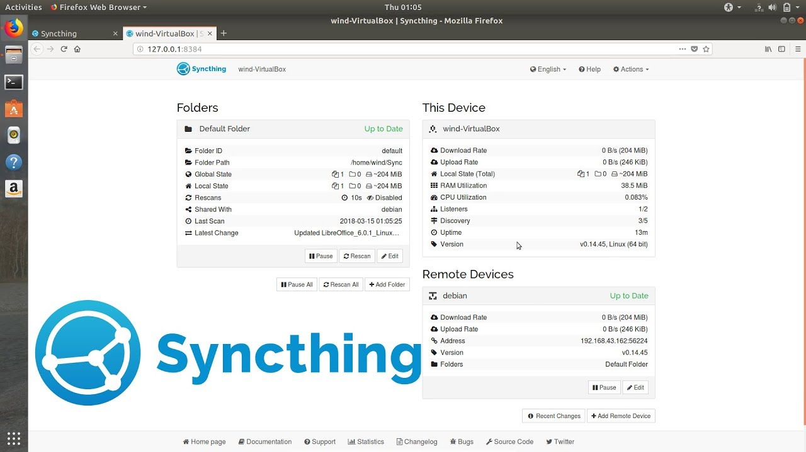

Slide 54
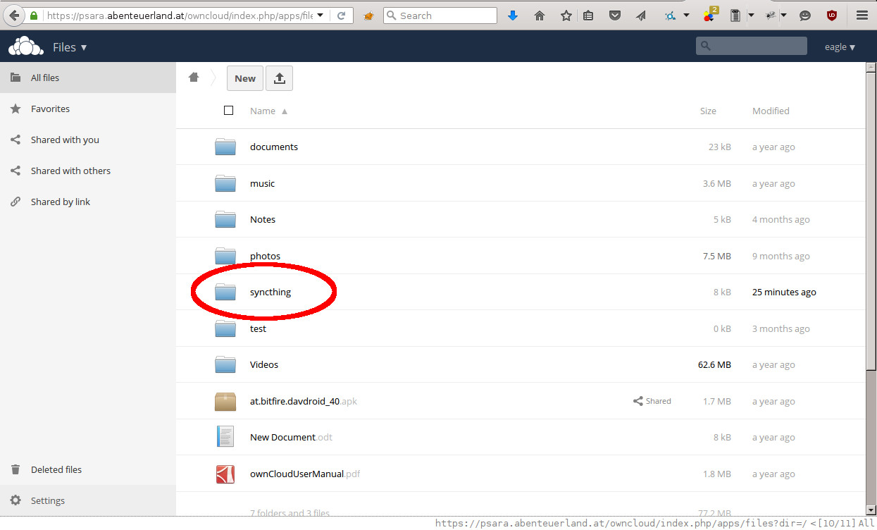

Slide 55
Syncthing
Pros: User controlled hardware, TLS end to end encryption, Local server and internet access. Open-source community and code. Docker images for multiple OS’s. Read only file and folder offers. UPnP port forward access. Small threat sacrifice (few access attacks). Simple transport layer, encrypted when device is off.

Slide 56
Syncthing
Cons: Open-source community help, some fee based help access. Possible need to create a port hole in firewall. Long time (hours) building of large data file indexes on low powered hardware.

Slide 57
Syncthing
https://en.wikipedia.org/wiki/Syncthing
https://en.wikipedia.org/wiki/Comparison_of_file_synchronization_software
https://www.gigenet.com/blog/how-to-set-up-a-complex-syncthing-network/

Slide 58
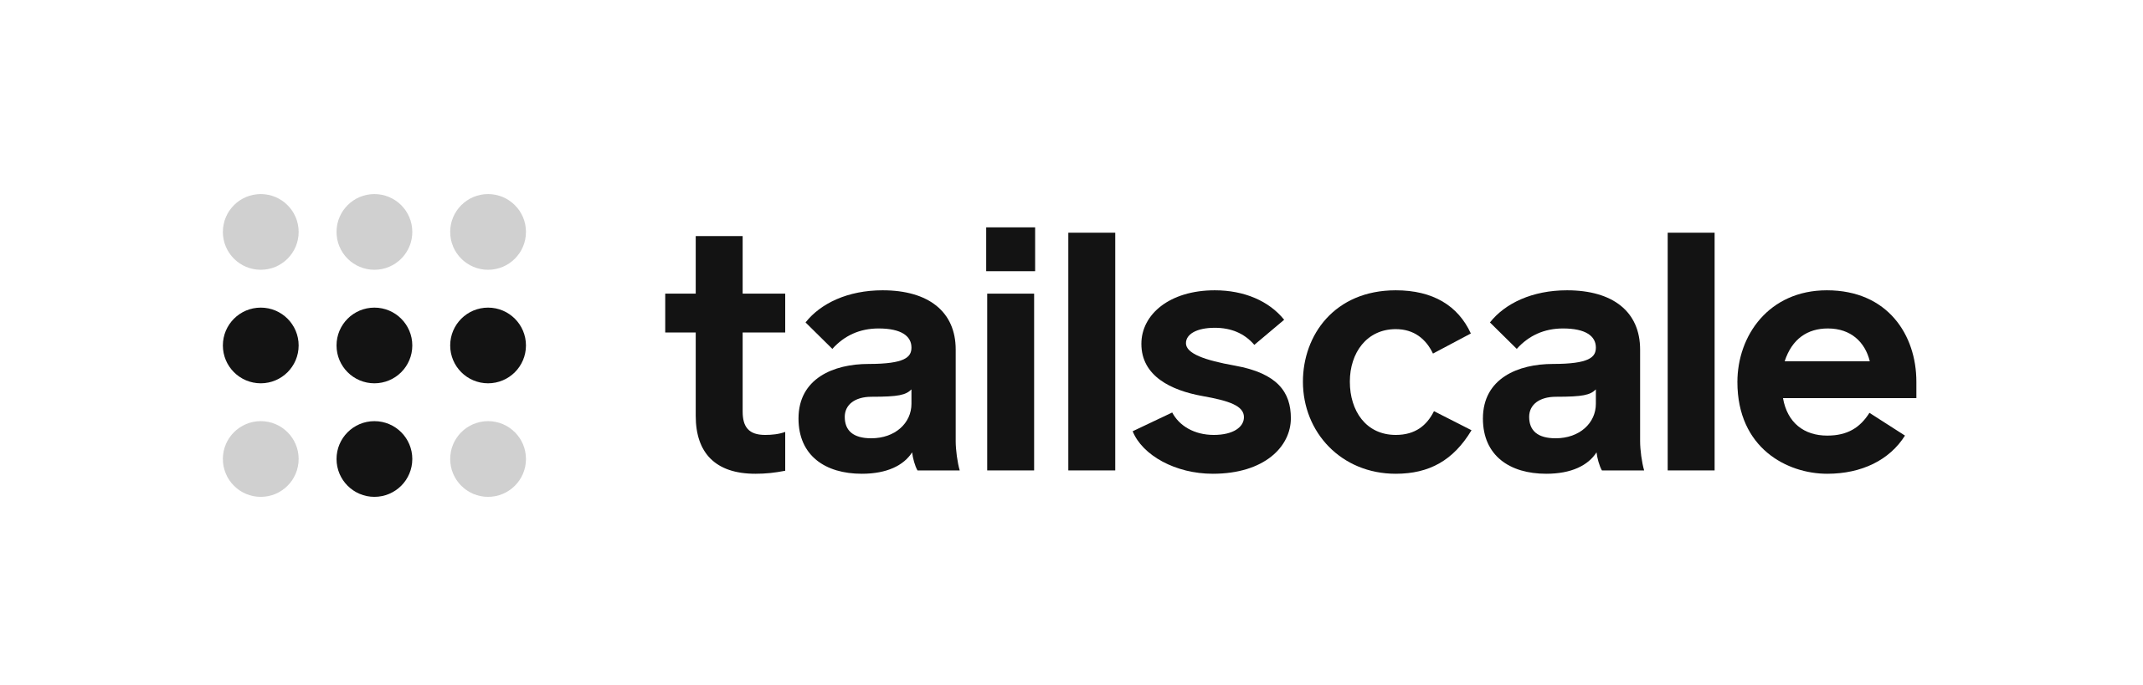
Tailscale

Slide 59
Tailscale
Tailscale creates a secure, encrypted mesh network for connecting devices, allowing you to access services and devices securely from anywhere. It is used to build private networks, securely access home servers, and share access with family or colleagues.

Slide 60
Tailscale
Tailscale key features include secure remote access, subnet routers to connect to local networks, exit nodes to route internet traffic, and Tailscale SSH for simplified, secure shell access. Build on the WireGuard Protocol.

Slide 61
Tailscale
WireGuard is an open source network tunneling protocol for creating encrypted communication channels. It's designed to replace other VPN protocols, such as OpenVPN and IPSec, as a simpler and lighter-weight alternative.

Slide 62
Tailscale
End to end encryption, centralized access control, private network, share of files, secure access across networks

Slide 63
Tailscale
Is Tailscale a VPN then? Tailscale prioritizes ease of use and direct connectivity, while traditional VPNs offer more granular control for complex enterprise security needs.

Slide 64
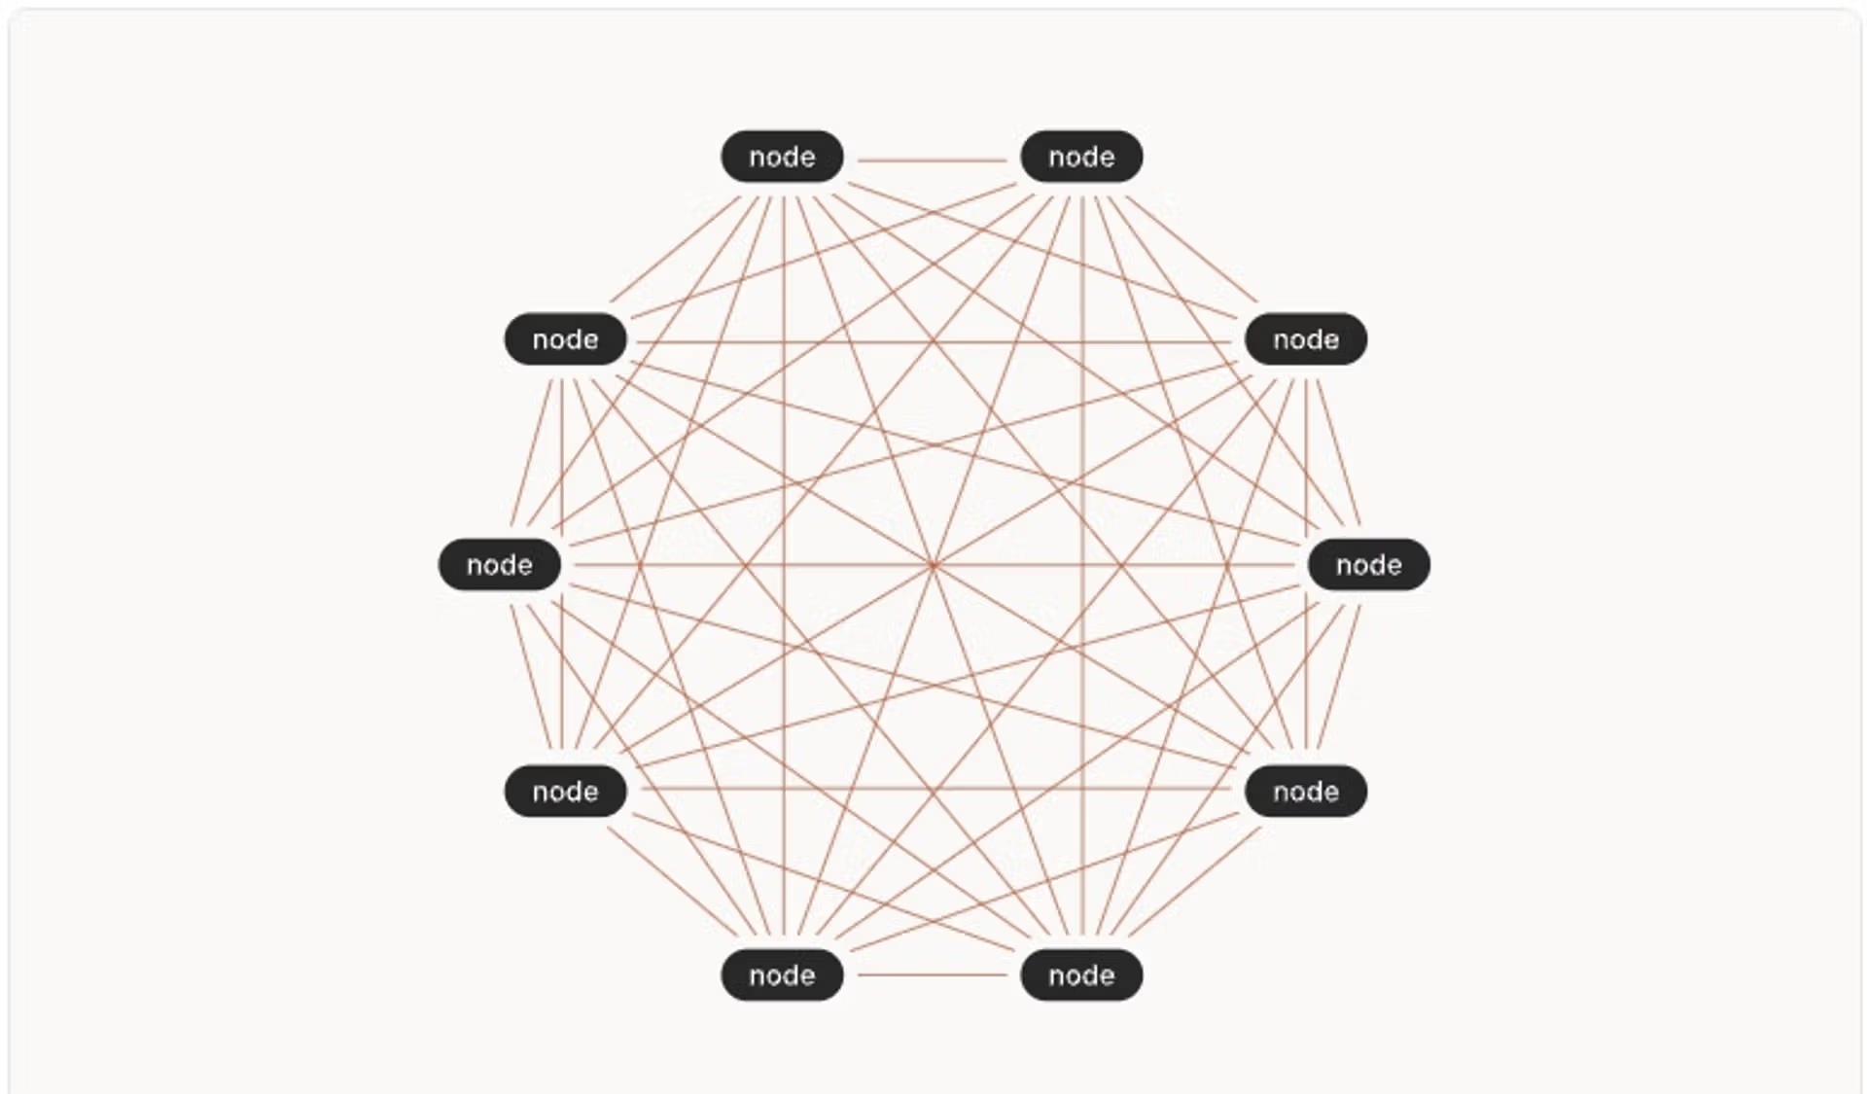

Slide 65
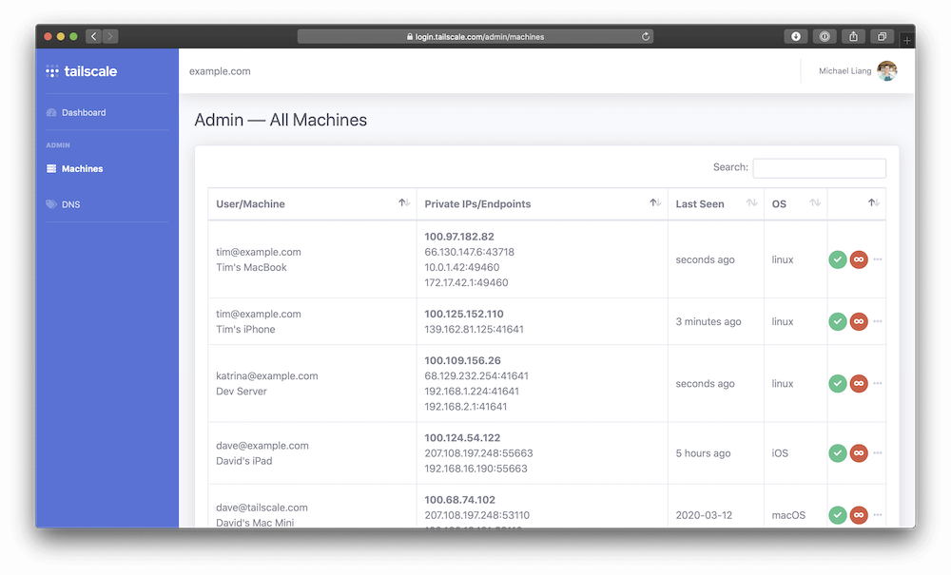

Slide 66
Tailscale
Pro: Extremely easy to set up, requires no deep technical knowledge, and provides direct peer-to-peer connections for lower latency access to resources. Comprehensive security features, more robust built-in control for enterprise needs, and allows for centralized management of the network

Slide 67
Tailscale
Con: Relies on Tailscale's management infrastructure relay servers for some traffic, which can add latency. Offers less built-in control over network segmentation and access compared to some traditional VPNs.
Can be complex to setup and maintain.

Slide 68
TailScale
https:///tailscale.com

Slide 69
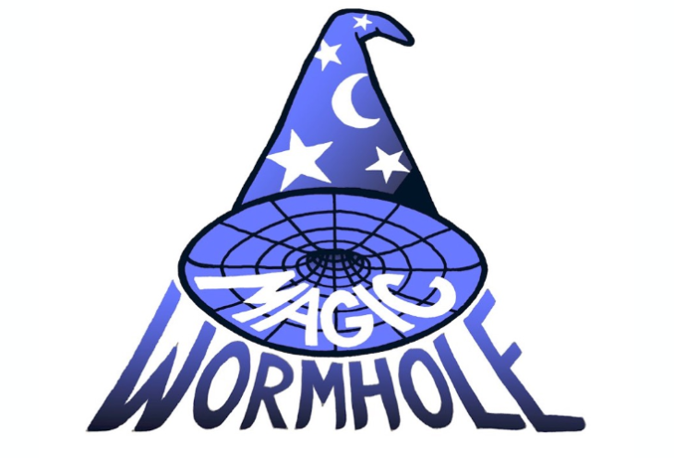
Magic Wormhole

Slide 70
Magic Wormhole
Single file move from one machine to another, files only not folders. Encrypted the entire length using PAKE (Password Authenticated Key Exchange). Python based pip install. Use of string as code and connection system.

Slide 71
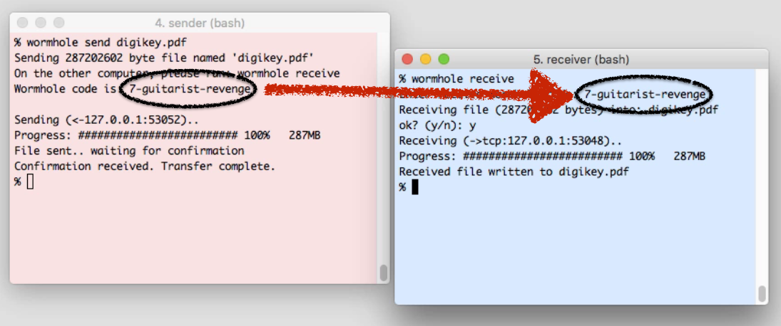

Slide 72
Magic Wormhole
Pros: Open source python based, fully encrypted between exchanges, command line based, use of tor onion services.

Slide 73
Magic Wormhole
Cons: Use of Rendezvous Server, open source, command line only, python based. Can be time consuming to set up. Not really designed for a large storage and retrieval option.

Slide 74
Magic Wormhole
https://magic-wormhole.readthedocs.io/en/latest/
http://www.lothar.com/%7Ewarner/MagicWormhole-PyCon2016.pdf

Slide 75

Onion Share

Slide 76
Onion Share
Securely and anonymously share files of any size. A web server is started, making OnionShare accessible as a Tor Onion Service, potentially temporarily or in a stealthy manner, over the Internet.
Open OnionShare, drag and drop files and folders into it, and click "Start Sharing". A secret .onion URL such as http://asxmi4q6i7pajg2b.onion/egg-cain will be presented for you to share.

Slide 77
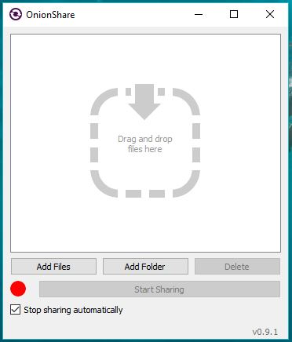

Slide 78
Onion Share
Pros: Tor based exchange, Open sourced code, near limitless file size exchange. Both ends do not have to know each other to exchange, just URL link. Able to host files on your server for others to access. Single install system of application.

Slide 79
Onion Share
Cons: Tor based exchange. Need to have tor browser system installed to use. Files only exchange not folders. Can be slow exchange on large files based on tor exchange traffic.

Slide 80
Onion Share
https://onionshare.org/
https://github.com/micahflee/onionshare/wiki

Slide 81
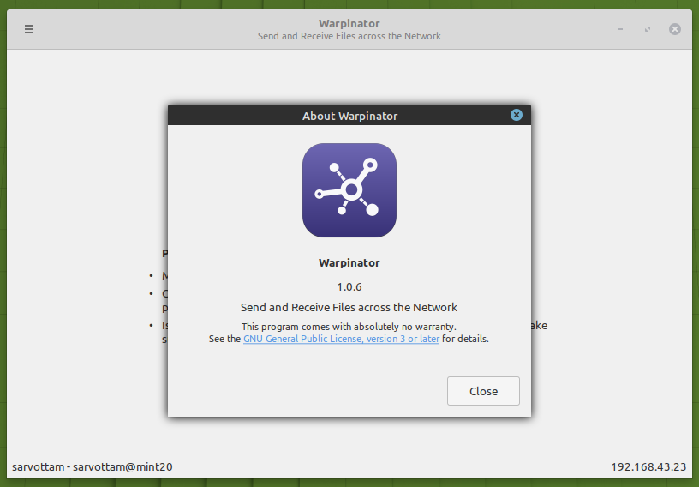
Warpinator

Slide 82
Warpinator
Developed by Linux Mint group.
Drag and Drop type GUI Front-end.
Default on Linux Mint 20, was called Giver on Linux Mint 6.
Similar to OnionShare and Wormhole in function.

Slide 83
Warpinator
Pros: Open Source, Quick file transfer.

Slide 84
Warpinator
Cons: Open Source, new to the market, requires python 3. Not fully encrypted data on source or destination.

Slide 85
Warpinator
https://github.com/linuxmint/warpinator
https://www.reddit.com/r/linuxmint/comments/h8x93l/how_to_install_warpinator_on_other_linux_distros/

Slide 86
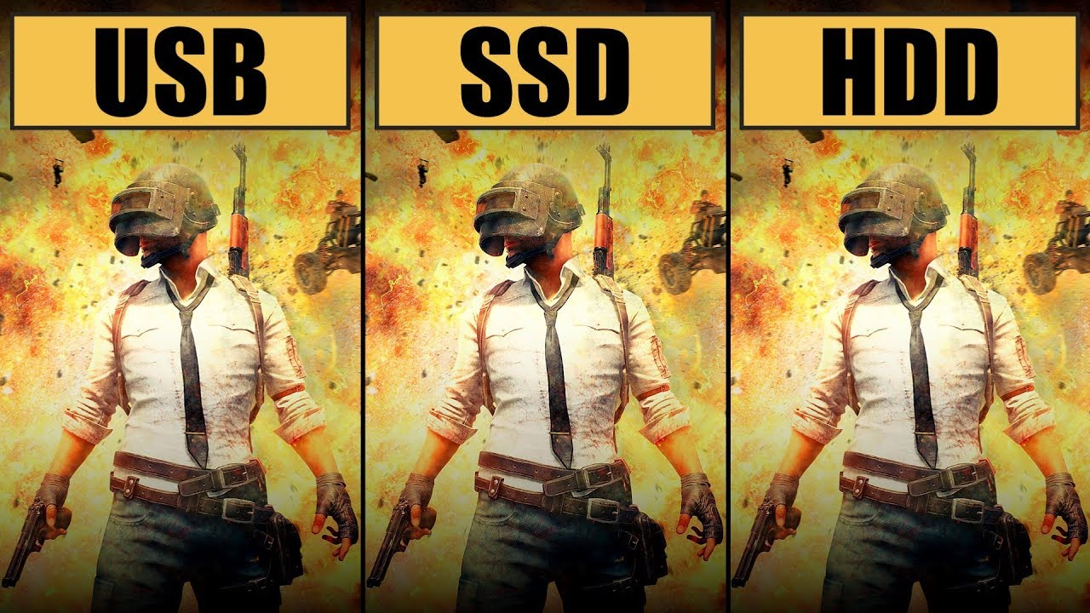
Carry with you

Slide 87
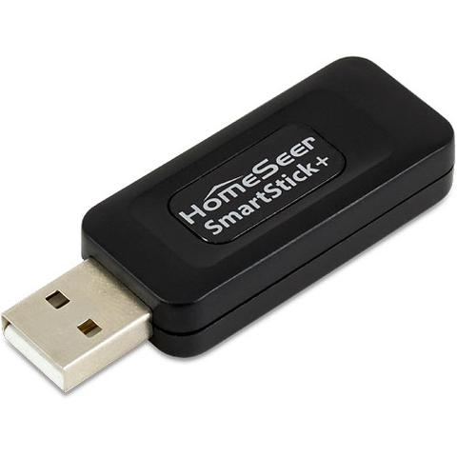
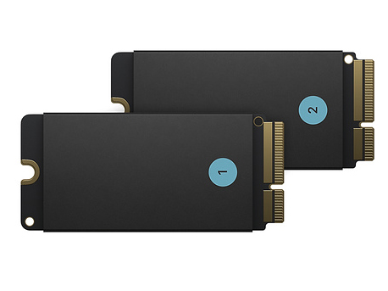
USB / SSD portable drive

Slide 88
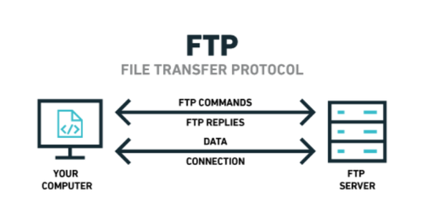
Local with you FTP/SFTP

Slide 89
WiFi Drives or Pi
Use a WiFi drive or even set up a P with a SSD drive to take with you. For security you will want to have the full drive encrypted and decrypt as needed. Some High-end drives/enclosures have encryption build it, but there is always a chance that they have a backdoor key to unlock. Its slim but its there. Then again are you a target?

Slide 90

A possible solution

Slide 91
What wanted, Rover
Want to be able to get data, but you may live in two or more places at different times of the year. Need to have your data backed up (replicated for safety), easy to access. Secure exchange of data and access of that data, cheap and reliable hardware.
I will expand on my solution idea..

Slide 92
Site 2
Villa in France
Site 1
My Island
Rover
Site 3
Michigan Home
Cold Storage
The Bunker

Slide 93
Software needed (may vary).
Syncthing – use for replication between sites, and if want from sites to your machines as you boot it up.
TailScale – use like VPN to access your machines remotely and securely, no need to mess with router pinholes or firewall rules. Tailscale on data storage machines and your access machine.
Samba/NFS/sftp (can work over tailscale) – to pull small bits of data as needed. Can just mount like a mount point.

Slide 94
Hardware needed (may vary).
UPS – to keep it all running during power glitches.
NAS hardware (truenas, sonology, ReadyNas, etc) – hardware to hold the data. May want one at each location you will be at, for access at fast speeds.
Raspberry Pi + SSD (as NAS hardware) – Simple and cheap, may want to stick with Pi 4 or 5 do to memory option and speed of processes.

Slide 95
WetWare MeatBag (may vary).
Person or persons to be able to go to site and restart or turn on equipment if issue.
Nice if able to handle tech issues, replace hardware if needed, etc.

Slide 96
Issue Planning.
A cold storage type data device that will just hold backup or used for back in case of DR needed. Have it not run all time but at different time boot up, use syncthing (or some other backup system) get synced with current data then shut down. Could even be a Big Three +1 encrypted location type thing.
Hardware replacement.

Slide 97
How it would work.
Person travels to three places each year, all the places are many miles apart and can take days to get to each. You set up the data hardware, in this case three equal type systems, and places at each site. Each of the systems would use Syncthing to keep the data mirrored (replicated) between each place. Using tailscale you can access each as if it was on a locale LAN. Setup something like SAMBA / NFS, or other to mount the local data system (to the person at that time) as a mounted drive/point.

Slide 98
How it would work.
Put and Get the data as you need from the local to you data storage machine. If any data changes the changes would be replicated to all the other systems using syncthing. Using the data system local to you would look like centralized data fast and mostly reliable. If you need to do any system access to other data storage machines you would use TailScale to access them via SSH or web access, you can do that no matter were you are.

Slide 99
Site 2
Villa in France
Site 1
My Island
Rover
Site 3
Michigan Home
Cold Storage
The Bunker

Slide 100
Sadly we still may have issues.
Hardware issues - far away from site having problem, a set of local fingers.
Being data is replicated, damage at one location of data will replicate it to other sites. (delete from one delete from all unless planned for)

Slide 101


Slide 102
Things that you should have
Ease of access to client and data.
Security, encrypted between you and other machines
Able to keep your data yours, and remove if wanted.
Data encrypted on all storage location, only you should have the key.

Slide 103
Final thoughts
Do your own research as well.
What would like to see?

Slide 104
Questions
You got them, I may be able to answer them.
My goto site - https://www.privacytools.io/
https://en.wikipedia.org/wiki/Comparison_of_file_synchronization_software

